Slide 1
DS 4300
Neo4j
Mark Fontenot, PhD
Northeastern University
Material referenced from Graph Algorithms - Practical Examples in Apache Spark and Neo4j by Needham and Hodler (O’Reilly Press, 2019)

Slide 2
Neo4j
A Graph Database System that supports both transactional and analytical processing of graph-based data
Relatively new class of no-sql DBs
Considered schema optional (one can be imposed)
Supports various types of indexing
ACID compliant
Supports distributed computing
Similar: Microsoft CosmoDB, Amazon Neptune

Slide 3
Neo4j - Query Language and Plugins
Cypher
Neo4j’s graph query language created in 2011
Goal: SQL-equivalent language for graph databases
Provides a visual way of matching patterns and relationships (nodes)-[:CONNECT_TO]->(otherNodes)
APOC Plugin
Awesome Procedures on Cypher
Add-on library that provides hundreds of procedures and functions
Graph Data Science Plugin
provides efficient implementations of common graph algorithms (like the ones we talked about yesterday)

Slide 4
Neo4j in Docker Compose

Slide 5
Docker Compose
Supports multi-container management.
Set-up is declarative - using YAML docker-compose.yaml file
services
volumes
networks, etc.
1 command can be used to start, stop, or scale a number of services at one time.
Provides a consistent method for producing an identical environment (no more “well… it works on my machine!)
Interaction is mostly via command line

Slide 6
docker-compose.yaml
services:
neo4j:
container_name: neo4j
image: neo4j:latest
ports:
- 7474:7474
- 7687:7687
environment:
- NEO4J_AUTH=neo4j/${NEO4J_PASSWORD}
- NEO4J_apoc_export_file_enabled=true
- NEO4J_apoc_import_file_enabled=true
- NEO4J_apoc_import_file_use__neo4j__config=true
- NEO4J_PLUGINS=["apoc", "graph-data-science"]
volumes:
- ./neo4j_db/data:/data
- ./neo4j_db/logs:/logs
- ./neo4j_db/import:/var/lib/neo4j/import
- ./neo4j_db/plugins:/plugins
Never put “secrets” in a docker compose file. Use .env files.

Slide 7
.env Files
.env files - stores a collection of environment variables
good way to keep environment variables for different platforms separate
.env.local
.env.dev
.env.prod
.env file
NEO4J_PASSWORD=abc123!!!

Slide 8
Docker Compose Commands
To test if you have Docker CLI properly installed, run: docker --version
Major Docker Commands
docker compose up
docker compose up -d
docker compose down
docker compose start
docker compose stop
docker compose build
docker compose build --no-cache

Slide 9
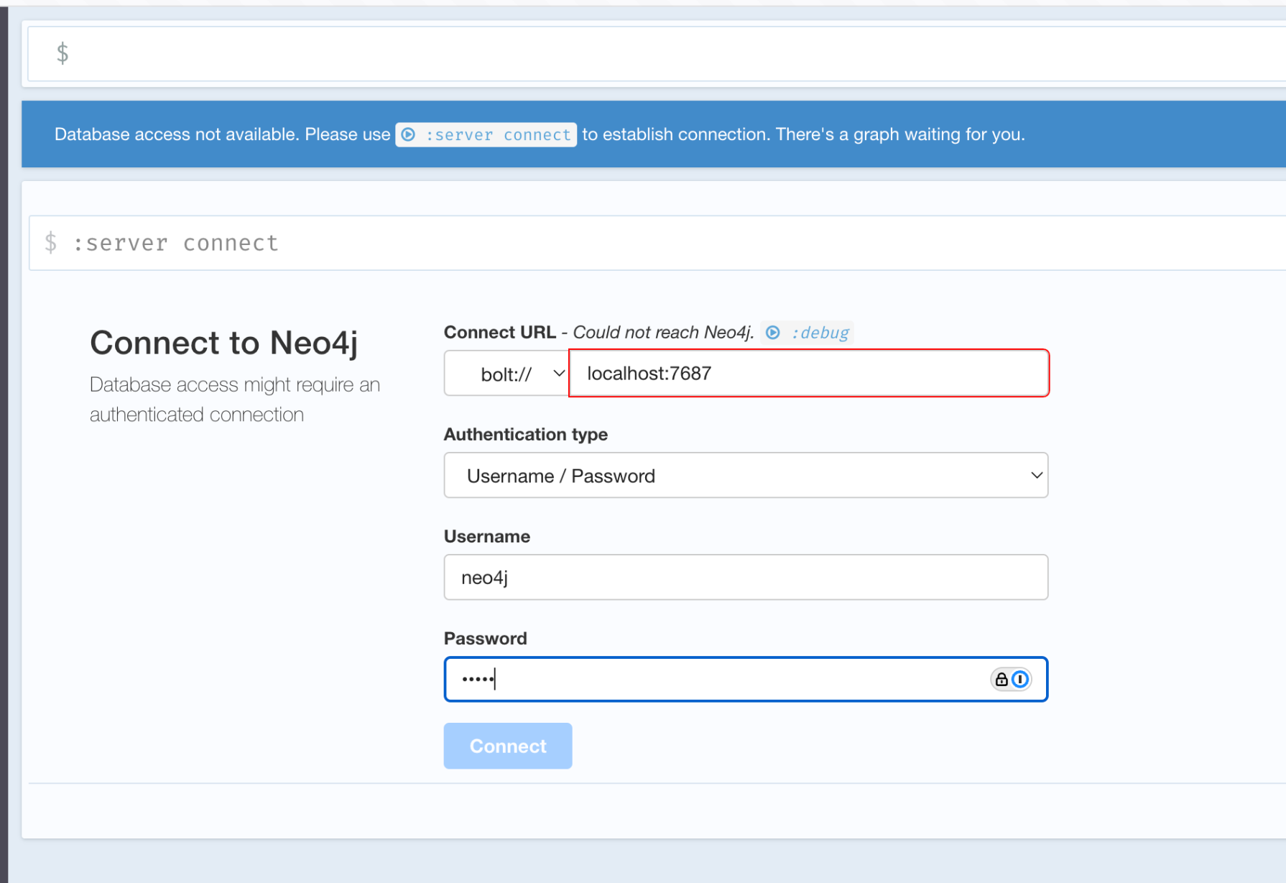
localhost:7474

Slide 10
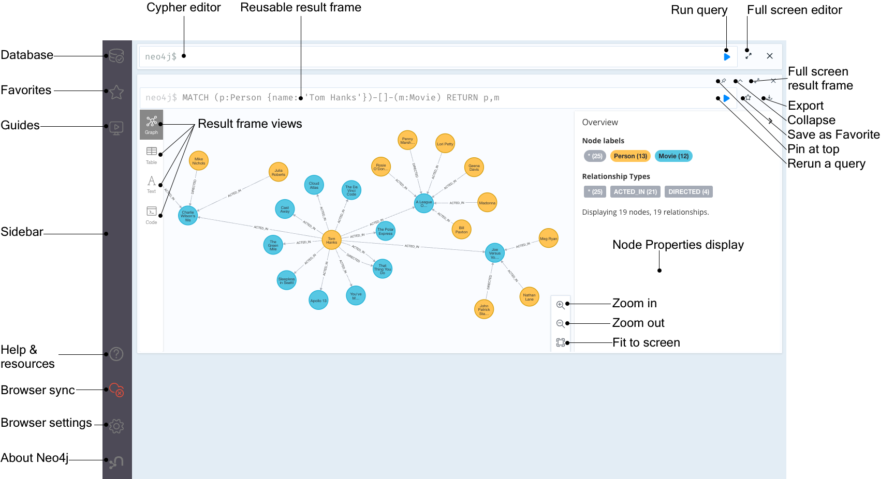
Neo4j Browser
localhost:7474 Then login.
https://neo4j.com/docs/browser-manual/current/visual-tour/

Slide 11
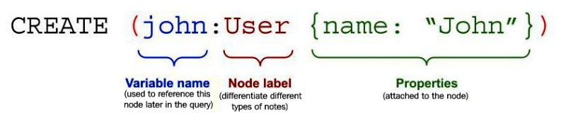
Inserting Data by Creating Nodes
CREATE (:User {name: "Alice", birthPlace: "Paris"})
CREATE (:User {name: "Bob", birthPlace: "London"})
CREATE (:User {name: "Carol", birthPlace: "London"})
CREATE (:User {name: "Dave", birthPlace: "London"})
CREATE (:User {name: "Eve", birthPlace: "Rome"})

Slide 12
Adding an Edge with No Variable Names
CREATE (:User {name: "Alice", birthPlace: "Paris"})
CREATE (:User {name: "Bob", birthPlace: "London"})
MATCH (alice:User {name:”Alice”})
MATCH (bob:User {name: “Bob”})
CREATE (alice)-[:KNOWS {since: “2022-12-01”}]->(bob)
Note: Relationships are directed in neo4j.

Slide 13
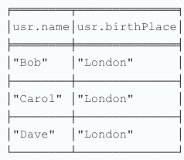
Matching
Which users were born in London?
MATCH (usr:User {birthPlace: “London”})
RETURN usr.name, usr.birthPlace

Slide 14
Download Dataset and Move to Import Folder
Clone this repo: https://github.com/PacktPublishing/Graph-Data-Science-with-Neo4j
In Chapter02/data of data repo, unzip the netflix.zip file
Copy netflix_titles.csv into the following folder where you put your docker compose file neo4j_db/neo4j_db/import

Slide 15
Importing Data

Slide 16
Basic Data Importing
Type the following into the Cypher Editor in Neo4j Browser
LOAD CSV WITH HEADERS FROM 'file:///netflix_titles.csv' AS line CREATE(:Movie { id: line.show_id, title: line.title, releaseYear: line.release_year } )

Slide 17
Loading CSVs - General Syntax
LOAD CSV
[WITH HEADERS]
FROM 'file:///file_in_import_folder.csv'
AS line
[FIELDTERMINATOR ',']
// do stuffs with 'line'

Slide 18
Importing with Directors this Time
LOAD CSV WITH HEADERS
FROM 'file:///netflix_titles.csv' AS line
WITH split(line.director, ",") as directors_list
UNWIND directors_list AS director_name
CREATE (:Person {name: trim(director_name)})
But this generates duplicate Person nodes (a director can direct
more than 1 movie)

Slide 19
Importing with Directors Merged
MATCH (p:Person) DELETE p
LOAD CSV WITH HEADERS
FROM 'file:///netflix_titles.csv' AS line
WITH split(line.director, ",") as directors_list
UNWIND directors_list AS director_name
MERGE (:Person {name: director_name})

Slide 20
Adding Edges
LOAD CSV WITH HEADERS
FROM 'file:///netflix_titles.csv' AS line
MATCH (m:Movie {id: line.show_id})
WITH m, split(line.director, ",") as directors_list
UNWIND directors_list AS director_name
MATCH (p:Person {name: director_name})
CREATE (p)-[:DIRECTED]->(m)

Slide 21
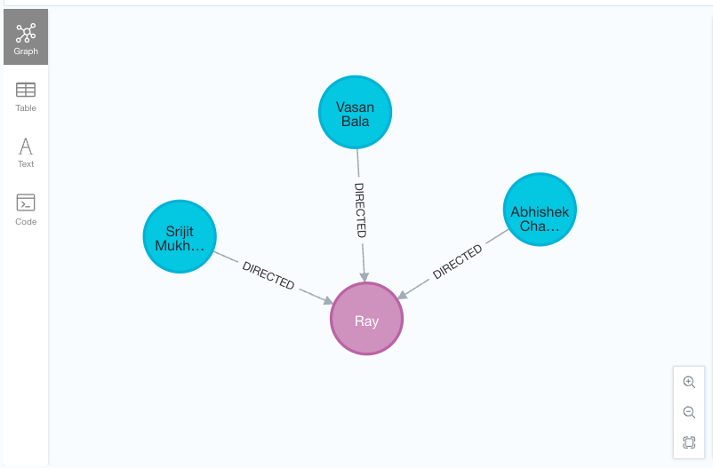
Gut Check
Let’s check the movie titled Ray:
MATCH (m:Movie {title: "Ray"})<-[:DIRECTED]-(p:Person)
RETURN m, p

Slide 22
??

